Slide 1

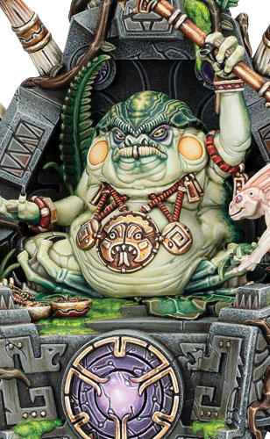


SLANN STARMASTER
5’’
Move
9
Health
5+
Save
6+
Ward
3
Wizard
2
Control
Melee Weapons | Attacks | Hit | Wound | Rend | Damage
Azure Lightning Crit (Mortal) | 6 | 3+ | 3+ | 1 | 1
6
Once Per Turn (army) Your Hero Phase | Once Per Turn, Any Hero Phase | Passive | Your Hero Phase
Celestial Reinforcement | Arcane Vassal | Masters of Order | Celestial Equilibrium
Pick a friendly SERAPHON unit that started the battle with 3 or more models and that has been destroyed to be the target. | Pick a friendly SKINK WIZARD wholly within 18" of this unit to be the target. |  | Make a casting roll of 2D6.
Roll a dice. On a 4+, set up a replacement unit with half the number of models from the target unit (rounding up) wholly within 12" of this unit and more than 9" from all enemy units. | Measure the range and visibility of the next SPELL ability used by this unit this phase from the target instead of from this unit. | Add 1 to casting rolls for this unit. In addition, this unit can use an UNBIND ability if an enemy WIZARD anywhere on the battlefield uses a SPELL ability (instead of 30’’) | For the rest of the turn, add 1 to casting rolls made for other friendly SERAPHON WIZARDS while they are wholly within 12" of this unit. Keywords: Spell
Keywords : Warmaster, Hero, Wizard (3), Infantry, Fly, Ward (6+), Order, Seraphon, Slann

Slide 2
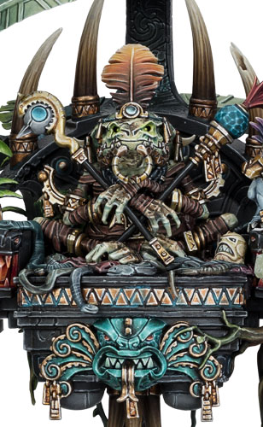


LORD KROAK
5’’
Move
18
Health
4+
Save
4+
Ward
3
Wizard
5
Control
Ranged Weapons | Range | Attacks | Hit | Wound | Rend | Dmg
Gaze of Kroak Shoot in Combat | 12’’ | 1 | 2+ | 3+ | 2 | D6
Melee Weapons | Attacks | Hit | Wound | Rend | Damage
Azyrite Force Barrier Crit (Mortal) | 2D6 | 3+ | 3+ | 1 | 1
7
End of Any Turn | Once Per Turn, Any Hero Phase | Passive | Your Hero Phase
Dead for Innumerable Ages | Arcane Vassal | Supreme Master of Order | Celestial Deliverance
This unit must use this ability each turn while it is damaged. Roll 3D6 and add the number of damage points this unit has to the roll. On a 20+, this unit is destroyed. Otherwise, Heal (18) this unit. | Pick a friendly SKINK WIZARD wholly within 18" of this unit to be the target. | Add 2 to casting rolls, and add 1 to unbinding rolls and banishment rolls for this unit. In addition, this unit can use an Unbind and Banish Manifestation anywhere on the battlefield. | This unit can cast this spell more than once per phase. Pick up to 3 different visible enemy units within 18" of this unit to be the targets, then make a casting roll of 2D6.
 | Measure the range and visibility of the next SPELL ability used by this unit this phase from the target instead of from this unit.
 |  |  | Inflict D3 mortal damage on each target. Keyword : Spell
Keywords : Warmaster, Unique, Hero, Wizard (3), Fly, Ward (4+), Order, Seraphon, Slann

Slide 3
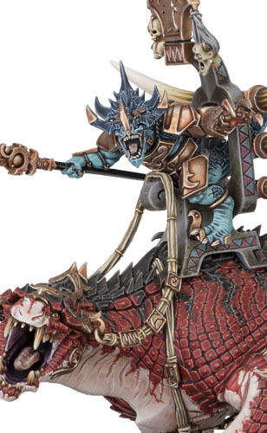



SAURUS OLDBLOOD ON CARNOSAUR
10’’
Move
14
Health
4+
Save
5
Control
Ranged Weapons | Range | Attacks | Hit | Wound | Rend | Dmg
Sunbolt Gauntlet Shoot in Combat | 12’’ | D6 | 3+ | 3+ | 1 | 1
Melee Weapons | Attacks | Hit | Wound | Rend | Damage
Sunstone Spear Charge (+1 damage) | 5 | 3+ | 3+ | 1 | 2
Carnosaur’s Massive Jaws Companion | 3 | 4+ | 2+ | 2 | 3
Carnosaur’s Clawed Forelimbs Companion | 4 | 4+ | 2+ | 1 | 3
Passive | Passive | Once Per Turn (army) Any Combat Phase | Passive
Battle Damaged | Spearhead of the Charge | Blood Frenzy | Terror
While this unit has 10 or more damage points, the Attacks characteristic of its Carnosaur’s Massive Jaws is 2. | If this unit charged this turn, add 1 to charge rolls for friendly SAURUS units while they are wholly within 18" of this unit for the rest of the turn. | If this unit is in combat with any damaged enemy MONSTERS, roll a dice. On a 3+, this unit has STRIKE-FIRST for the rest of the turn. Keywords: Rampage | Subtract 2 from the control scores of enemy units while they are in combat with this unit.
Keywords : Hero, Monster, Order, Seraphon, Saurus

Slide 4
SAURUS OLDBLOOD ON CARNOSAUR
10’’
Move
14
Health
4+
Save
5
Control
Melee Weapons | Attacks | Hit | Wound | Rend | Damage
Sunstone Spear and Sunbolt Charge (+1 damage) | 6 | 3+ | 3+ | 1 | 2
Carnosaur’s Massive Jaws Companion | 3 | 4+ | 2+ | 2 | 4
Carnosaur’s Clawed Forelimbs Companion | 5 | 4+ | 2+ | 1 | 3
Passive | Passive | Once Per Turn (army) Any Combat Phase | Passive
Battle Damaged | Frenzied by Blood | Thunderous Roar | Alpha Predator
While this unit has 10 or more damage points, the Attacks characteristic of its Carnosaur’s Massive Jaws is 2. | Add 1 to the Damage characteristic of this unit’s Companion weapons while it is within 6" of any damaged enemy units or of any enemy units that had any models slain in the same turn. | Pick an enemy unit in combat with this unit to be the target. Roll a dice. On a 3+, the target cannot use commands for the rest of the turn. Keywords: Rampage | Friendly Aggradon Lancers do not lose rage tokens at the end of the turn while they are wholly within 12’’ of this unit.
Keywords : Hero, Monster, Order, Seraphon, Saurus

Slide 5
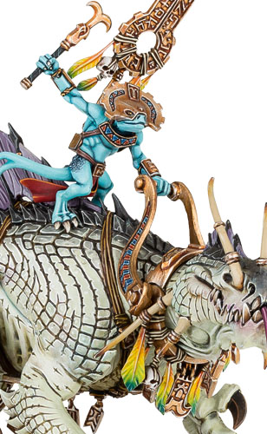

SKINK ON TROGLODON
10’’
Move
14
Health
4+
Save
1
Wizard
5
Control
Ranged Weapons | Range | Attacks | Hit | Wound | Rend | Dmg
Troglodon's Noxious Spittle Shoot in Combat Companion | 15’’ | D6 | 3+ | 3+ | 1 | 2
Melee Weapons | Attacks | Hit | Wound | Rend | Damage
Divining Rod | 2 | 4+ | 4+ | 1 | D3
Troglodon’s Jaws Crit (mortal) Companion | 3 | 4+ | 3+ | 1 | 3
Troglodon’s Talons Companion | 2 | 4+ | 3+ | 1 | 2
Passive | Once Per Turn (army) Any Combat Phase | End of Any Turn | Passive
Battle Damaged | Noxious Roar | Trolglodon Regeneration | Terror
While this unit has 10 or more damage points, the Attacks characteristic of its Troglodon’s Jaws is 2. | Pick up to 3 enemy units in combat with this unit to be the targets. Roll a dice for each target. On a 3+, subtract 1 from hit rolls for the target’s attacks for the rest of the turn. Keywords: Rampage | Heal (D3) this unit. | Subtract 2 from the control scores of enemy units while they are in combat with this unit.
Keywords : Hero, Monster, Wizard(1), Order, Seraphon, Skink

Slide 6
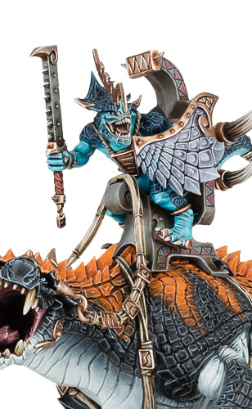

SAURUS SCAR-VETERAN ON CARNOSAUR
10’’
Move
14
Health
4+
Save
5
Control
Melee Weapons | Attacks | Hit | Wound | Rend | Damage
Relic Celestite Weapon | 5 | 3+ | 3+ | 1 | 3
Carnosaur’s Massive Jaws Companion | 3 | 4+ | 2+ | 2 | 3
Carnosaur’s Clawed Forelimbs Companion | 4 | 4+ | 2+ | 1 | 3
Passive | Once Per Turn (Army) End of Any Turn | Passive
Battle Damaged | Maim and Tear | Terror
While this unit has 10 or more damage points, the Attacks characteristic of its Carnosaur’s Massive Jaws is 2. | Pick an enemy HERO in combat with this unit to be the target. Roll a number of dice equal to the number of damage points the target has. For each 5+, inflict 1 mortal damage on the target. Keywords: Rampage | Subtract 2 from the control scores of enemy units while they are in combat with this unit.
Keywords : Hero, Cavalry, Order, Seraphon, Saurus

Slide 7
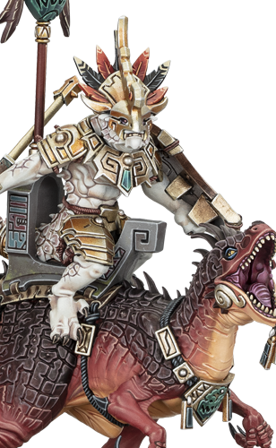
SAURUS SCAR-VETERAN ON AGGRADON
10’’
Move
8
Health
4+
Save
2
Control
Melee Weapons | Attacks | Hit | Wound | Rend | Damage
Celestite Spear and Club Charge (+1 Damage) | 4 | 3+ | 3+ | 2 | 2
Aggradon’s Rending Bites and Striking Talons Companion | 3 | 4+ | 3+ | 2 | 2
Once Per Battle (Army) Any Combat Phase | Passive
Alpha Roar | Primal Rage
Pick this unit and each friendly Aggradon Lancers unit wholly within 12" of it to be the targets. Add 1 to the Attacks characteristic of the targets’ Companion weapons for the rest of the turn. In addition, place a rage token next to each target, to a maximum of 3 per unit. | This unit must use this ability each turn. If this unit used any FIGHT abilities this turn, place a rage token next to it, to a maximum of 3. If this unit did not use any FIGHT abilities this turn, remove all rage tokens it has. Add 1 to the Attacks characteristic of this unit’s Companion weapons for each rage token it has until the end of the next turn.
Keywords : Hero, Cavalry, Order, Seraphon, Saurus

Slide 8
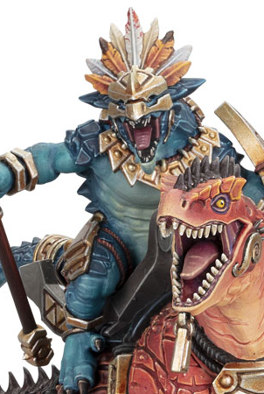
AGGRADON LANCERS
10’’
Move
5
Health
4+
Save
2
Control
Melee Weapons | Attacks | Hit | Wound | Rend | Damage
Celestite Spear and Club Anti-MONSTER (+1 Rend) Charge (+1 Damage) | 3 | 3+ | 3+ | 1 | 1
Aggradon’s Rending Bites and Striking Talons Companion | 3 | 4+ | 3+ | 2 | 2
Passive
Primal Rage
This unit must use this ability each turn. If this unit used any FIGHT abilities this turn, place a rage token next to it, to a maximum of 3. If this unit did not use any FIGHT abilities this turn, remove all rage tokens it has. Add 1 to the Attacks characteristic of this unit’s Companion weapons for each rage token it has until the end of the next turn.
Keywords : Cavalry, Champion, Musician (1/3), Standard Bearer (1/3), Order, Seraphon, Saurus

Slide 9
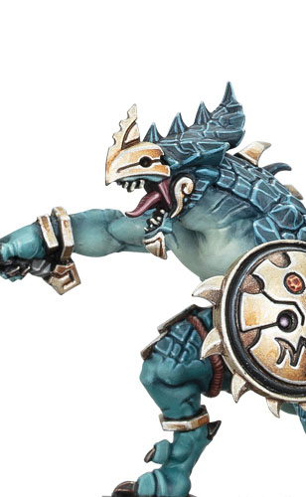
SAURUS WARRIORS
5’’
Move
2
Health
4+
Save
1
Control
Melee Weapons | Attacks | Hit | Wound | Rend | Damage
Celestite Weapon | 2 | 3+ | 3+ | 1 | 1
Passive
Ordered Cohorts
Add 1 to save rolls for this unit while each model in this unit is contesting an objective you control.
Keywords : Infantry, Champion, Musician (1/10), Standard Bearer (1/10), Order, Seraphon, Saurus

Slide 10
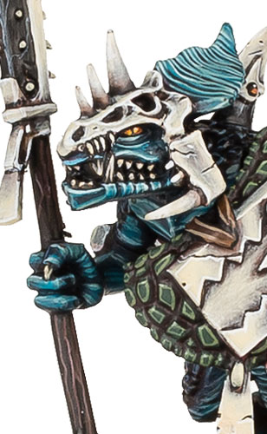

SAURUS GUARD
5’’
Move
2
Health
3+
Save
1
Control
Melee Weapons | Attacks | Hit | Wound | Rend | Damage
Celestite Polearm | 3 | 3+ | 3+ | 1 | 1
Passive
Selfless Protectors
While any friendly SLANN units are within this unit’s combat range, both this unit and those SLANN units have WARD (5+)
Keywords : Infantry, Champion, Musician (1/5), Standard Bearer (1/5), Order, Seraphon, Saurus

Slide 11
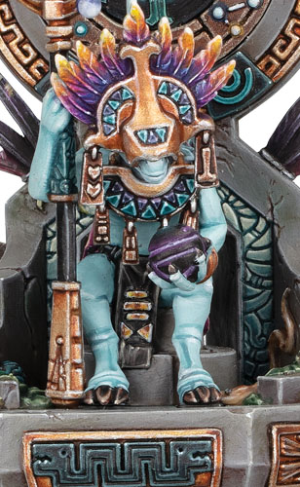
SKINK STARSEER
5’’
Move
6
Health
4+
Save
2
Wizard
2
Control
Melee Weapons | Attacks | Hit | Wound | Rend | Damage
Astromancer’s Staff | 2 | 4+ | 3+ | 1 | D3
Your Hero Phase | Once Per Battle (Army) Your Hero Phase
Celestial Doom | Scry the Stars
Pick a visible enemy unit within 18’’ to be the target, then make a casting roll of 2D6 | Roll a number of dice equal to the current battle round number. For each 3+, pick a friendly Seraphon unit wholly within 18" of this unit. That unit has WARD (5+) until the start of your next turn.
Ward rolls cannot be made for the target for the rest of the turn
6
Keywords : Hero, Wizard (2), Infantry, Fly, Order, Seraphon, Skink

Slide 12
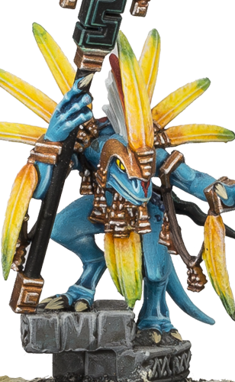
SKINK STARPRIEST
8’’
Move
5
Health
6+
Save
1
Wizard
2
Control
Melee Weapons | Attacks | Hit | Wound | Rend | Damage
Serpent Staff | 3 | 4+ | +4 | 1 | D3
Passive
Serpent Staff
Pick a visible friendly SERAPHON unit wholly within 18" of this unit to be the target.
Roll a dice. On a 2+, the target’s melee weapons have Crit (Auto-wound) until the start of your next turn.
Keywords : Hero, Wizard (1), Infantry, Order, Seraphon, Skink

Slide 13
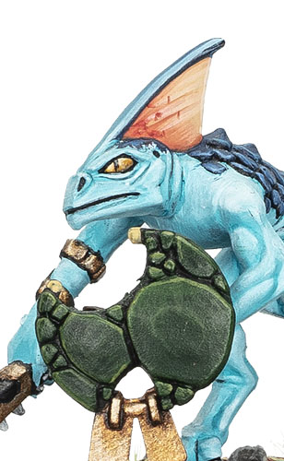
SKINKS
8’’
Move
1
Health
6+
Save
1
Control
Ranged Weapons | Range | Attacks | Hit | Wound | Rend | Dmg
Javelins and Boltspitters Shoot in Combat | 12’’ | 2 | 4+ | 4+ | 0 | 1
Melee Weapons | Attacks | Hit | Wound | Rend | Damage
Celestite Daggers and Moonstone Clubs | 1 | 4+ | 5+ | 0 | 1
Passive
Swift and Nimbe
When this unit uses the ‘Redeploy’ command, when determining the distance this unit can move, you can roll 2 dice instead of 1 and pick either result.
Keywords : Infantry, Champion, Order, Seraphon, Skink

Slide 14
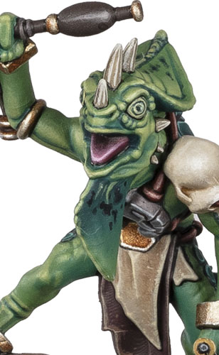

HUNTERS OF HUANCHI WITH DARTPIPES
8’’
Move
1
Health
6+
Save
5+
Ward
1
Control
Ranged Weapons | Range | Attacks | Hit | Wound | Rend | Dmg
Dartpipe Crit (Auto-wound) | 10’’ | 2 | 3+ | 3+ | 0 | 1
Melee Weapons | Attacks | Hit | Wound | Rend | Damage
Feeble Claws | 1 | 4+ | 5+ | 0 | 1
Deployment Phase | Your Mouvement Phase | Any Shooting Phase
Hidden Hunters | Chameleon Ambush | Star-Venom
Pick this unit if it has not been deployed. Set up this unit in reserve in ambush. It has now been deployed. Keyword : Deploy | Pick this unit if it is in ambush. Set up this unit anywhere on the battlefield more than 9’’ from all enemy units. | Pick an enemy unit that had any damage point allocated to it this turn by attacks made with this unit's Dartpipe to be the target. Roll a dice. On a 2+ subtract 1 from wound rolls for the target's combat attacks for the rest of the turn.
Keywords : Infantry, Champion (1/5), Musician (1/5), Ward (5+), Order, Seraphon, Skink

Slide 15
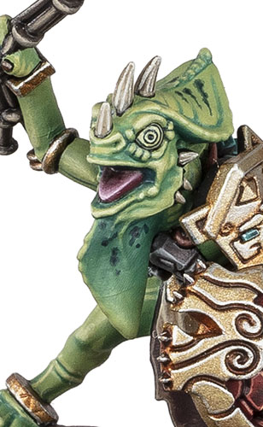
HUNTERS OF HUANCHI WITH STARSTONE BOLAS
8’’
Move
1
Health
6+
Save
5+
Ward
1
Control
Ranged Weapons | Range | Attacks | Hit | Wound | Rend | Dmg
Hunter Javelin 1/5 : Not Champion | 10’’ | 1 | 3+ | 3+ | 1 | 2
Starstone Bolas | 10’’ | 1 | 3+ | 4+ | 0 | 1
Melee Weapons | Attacks | Hit | Wound | Rend | Damage
Hunter Javelin 1/5 : Not Champion | 3 | 3+ | 4+ | 1 | 2
Moonstone Club | 2 | 4+ | 5+ | 0 | 1
Deployment Phase | Your Mouvement Phase | Any Shooting Phase
Hidden Hunters | Chameleon Ambush | Starstone Bolas
Pick this unit if it has not been deployed. Set up this unit in reserve in ambush. It has now been deployed. Keyword : Deploy | Pick this unit if it is in ambush. Set up this unit anywhere on the battlefield more than 9’’ from all enemy units. | Pick an enemy unit that was targeted by this unit’s Starstone Bolas this turn to be the target. Roll a dice. On a 3+, until the start of your next turn, subtract 1 from the number of dice rolled when making charge rolls for the target (minimum 1).
Keywords : Infantry, Champion (1/5), Musician (1/5), Ward (5+), Order, Seraphon, Skink

Slide 16
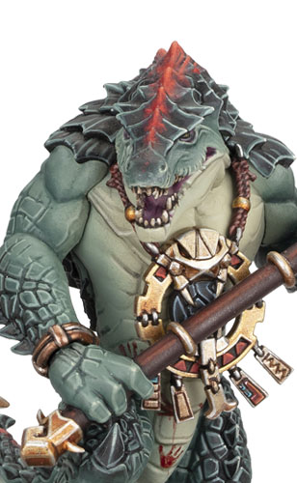
KROXIGOR WARSPAWNED
5’’
Move
6
Health
4+
Save
2
Control
Melee Weapons | Attacks | Hit | Wound | Rend | Damage
Starfang Warpick (1/3) Anti-MONSTER (+1 Rend) | 4 | 3+ | 2+ | 1 | 3
Drakefang Warpick Anti-MONSTER (+1 Rend) | 4 | 4+ | 2+ | 1 | 2
Passive | Passive
Spawn of Sotek | Heavey-scaled Skin
Add 1 to the Damage characteristic of this unit’s melee weapons while this unit is wholly within 12" of any friendly SKINK INFANTRY or SKINK CAVALRY units in combat. | Subtract 1 from the Rend characteristic of ranged weapons used for shooting attacks that target this unit.
Keywords : Infantry, Order, Seraphon, Kroxigor

Slide 17
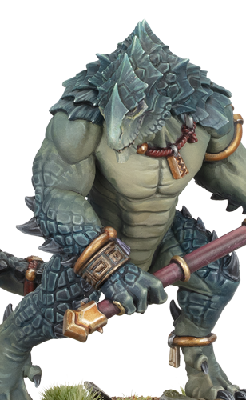
KROXIGOR
5’’
Move
6
Health
4+
Save
2
Control
Melee Weapons | Attacks | Hit | Wound | Rend | Damage
Moonstone Hammer (1/3) Anti-INFANTRY (+1 Rend) | 4 | 3+ | 2+ | 1 | 3
Drakebite Maul Anti-INFANTRY (+1 Rend) | 4 | 4+ | 2+ | 1 | 2
Passive
Brutal Blows
Add 1 to the Damage characteristic of this unit’s melee weapons for attacks that target an enemy unit that has 10 or more models.
Keywords : Infantry, Order, Seraphon, Kroxigor

Slide 18
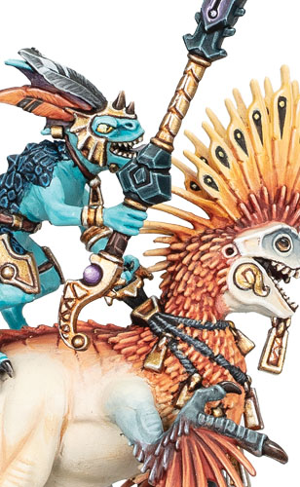
RAPTADON CHARGERS
12’’
Move
3
Health
5+
Save
1
Control
Melee Weapons | Attacks | Hit | Wound | Rend | Damage
Tepok Lance Charge (+1 Damage) | 3 | 4+ | 4+ | 1 | 1
Raptadon’s Serrated Fangs Companion | 3 | 4+ | 3+ | 1 | 1
Passive
Cold-blooded Unity
Add 1 to hit rolls for this unit’s combat attacks if they target an enemy unit that was targeted by shooting attacks made by a friendly Raptadon Hunters unit in the same turn.
Keywords : Cavalry, Champion, Musician (1/5), Standard Bearer (1/5), Order, Seraphon, Skink

Slide 19
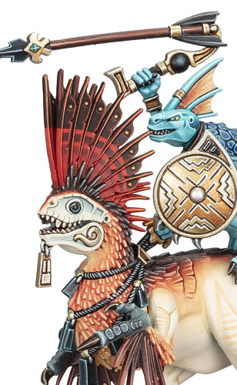
RAPTADON HUNTERS
12’’
Move
3
Health
5+
Save
1
Control
Ranged Weapons | Range | Attacks | Hit | Wound | Rend | Dmg
Starstone Atlatl | 12’’ | 2 | 4+ | 4+ | 2 | 1
Melee Weapons | Attacks | Hit | Wound | Rend | Damage
Weighted Moonstone Club | 3 | 4+ | 5+ | 0 | 1
Raptadon’s Serrated Fangs Companion | 3 | 4+ | 3+ | 1 | 1
Any Charge Phase
Deadly Cohesion
If this unit is not in combat, pick a friendly Raptadon Chargers unit that charged this turn and is within 12" of this unit to be the target.
This unit can use a SHOOT ability as if it were your shooting phase. It must target a visible enemy unit in combat with the target.
Keywords : Cavalry, Champion, Musician (1/5), Standard Bearer (1/5), Order, Seraphon, Skink

Slide 20
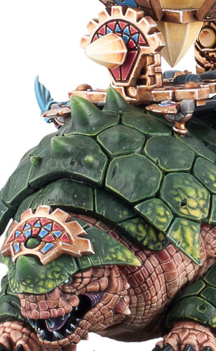
BASTILADON WITH SOLAR ENGINE
5’’
Move
12
Health
2+
Save
5
Control
Ranged Weapons | Range | Attacks | Hit | Wound | Rend | Dmg
Solar Engine Crit (2 Hits) | 18’’ | 3 | 3+ | 3+ | 2 | 3
Handlers’ Meteoric Javelins Shoot in combat | 12’’ | 6 | 4+ | 4+ | 0 | 1
Melee Weapons | Attacks | Hit | Wound | Rend | Damage
Bludgeoning Tail Companion | 3 | 3+ | 3+ | 1 | D3
Once Per Turn (army) Any Combat Phase
Tail Swipe
Pick an enemy unit in combat with this unit to be the target.
Roll a dice for each model in the target unit, to a maximum of 8. For each 5+, inflict 1 mortal damage on the target. Keywords: Rampage
Keywords : Monster, Order, Seraphon, Skink

Slide 21
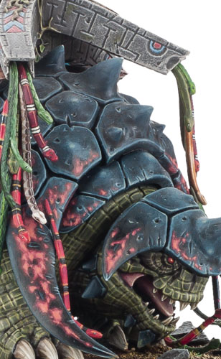
BASTILADON WITH ARK OF SOTEK
5’’
Move
12
Health
2+
Save
5
Control
Ranged Weapons | Range | Attacks | Hit | Wound | Rend | Dmg
Handlers’ Meteoric Javelins Shoot in combat | 12’’ | 6 | 4+ | 4+ | 0 | 1
Melee Weapons | Attacks | Hit | Wound | Rend | Damage
Bludgeoning Tail Companion | 3 | 3+ | 3+ | 1 | D3
Ark of Sotek Crit (Mortal) Companion | 20 | 4+ | 5+ | 0 | 1
Once Per Turn (army) Any Combat Phase
Ark of Sotek
Pick up to 3 different enemy units within 9" of this unit to be the targets.
Roll a D3 for each target. On a 2+, inflict an amount of mortal damage on the target equal to the roll. Keywords: Rampage
Keywords : Monster, Order, Seraphon, Skink

Slide 22
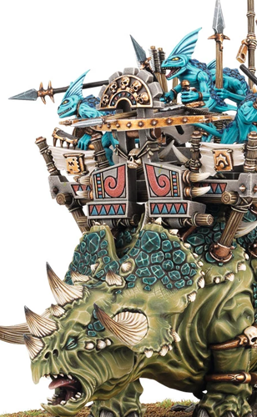


STEGADON
8’’
Move
14
Health
4+
Save
5
Control
Ranged Weapons | Range | Attacks | Hit | Wound | Rend | Dmg
Handlers’ Meteoric Javelins Shoot in combat | 12’’ | 6 | 4+ | 4+ | 0 | 1
Sunfire Throwers Anti-Infantry (+1 Rend) Crit (2 Hits) | 10’’ | 2D6 | 3+ | 3+ | 0 | 1
Skystreak Bow Anti-Monster(+1 Rend) | 18’’ | 3 | 3+ | 3+ | 1 | 2
Melee Weapons | Attacks | Hit | Wound | Rend | Damage
Stegadon’s Horns and Jaws Charge (+1 Damage) Companion | 6 | 4+ | 2+ | 1 | 2
Passive | Once per Turn (army) Any Charge Phase
Battle Damaged | Unstoppable Stampede
While this unit has 10 or more damage points, the Attacks characteristic of its Stegadon’s Horns and Jaws is 4. | If this unit charged this phase, pick an enemy INFANTRY unit in combat with it to be the target. Inflict D3 mortal damage on the target. Then, this unit can move 2D6". This unit can pass through models in the target unit but must end that move in combat. Keywords: Rampage
Keywords : Monster, Order, Seraphon, Skink

Slide 23
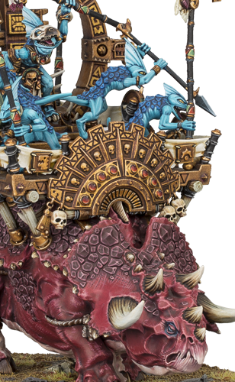
ENGINE OF THE GODS
8’’
Move
14
Health
4+
Save
5
Control
Ranged Weapons | Range | Attacks | Hit | Wound | Rend | Dmg
Handlers’ Meteoric Javelins Shoot in combat | 12’’ | 6 | 4+ | 4+ | 0 | 1
Melee Weapons | Attacks | Hit | Wound | Rend | Damage
Stegadon’s Horns and Jaws Charge (+1 damage) Companion | 6 | 4+ | 2+ | 1 | 2
Passive | Your Hero Phase |  | Once Per Turn (army) Any Combat Phase
Battle Damaged | Cosmic Engine |  | Crest of Horns
While this unit has 10 or more damage points, the Attacks characteristic of its Stegadon’s Horns and Jaws is 4. | If it will reserve the power, place a cosmic power token next to this unit. If it will harness the power, roll a dice and add the number of cosmic power tokens this unit has to the roll. Then, remove all cosmic power tokens. TARGET : friendly SERAPHON units wholly within 12" | Healing Light: On a 3+, you can Heal (D3) all TARGET. | Pick an enemy unit that charged this turn and is in combat with this unit to be the target.
 |  | Starlight Summons: On a 5+, you can pick up to 3 TARGET Return 1 slain model to each unit.
 |  |  | Roll a D3. On a 2+: • Inflict an amount of mortal damage • Add 1 to save rolls for attacks made by that enemy unit for the rest of the turn. Keywords: Rampage
 |  | Time Slows: On a 6+, you can pick up to 3 TARGET Those units have STRIKE-FIRST for the rest of the turn.
Keywords : Monster, Order, Seraphon, Skink

Slide 24
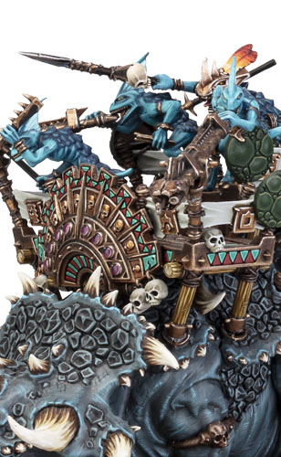
STEGADON CHIEF
8’’
Move
14
Health
4+
Save
5
Control
Ranged Weapons | Range | Attacks | Hit | Wound | Rend | Dmg
Handlers’ Meteoric Javelins Shoot in combat | 12’’ | 6 | 4+ | 4+ | 0 | 2
Sunfire Throwers Anti-Infantry (+1 Rend) Crit (2 Hits) | 10’’ | 2D6 | 3+ | 3+ | 0 | 1
Skystreak Bow Anti-Monster(+1 Rend) | 18’’ | 3 | 3+ | 3+ | 1 | 2
Melee Weapons | Attacks | Hit | Wound | Rend | Damage
Stegadon’s Horns and Jaws Charge (+1 Damage) Companion | 6 | 4+ | 2+ | 1 | 2
Meteoric Warspear | 3 | 3+ | 3+ | 1 | 1
Passive | Passive | Once Per Turn (Army), Any Combat Phase
Battle damaged | Skink Coordination | Crushing Stomps
While this unit has 10 or more damage points, the Attacks characteristic of its Stegadon’s Horns and Jaws is 4. | If a friendly non-MONSTER SKINK unit uses the ‘Redeploy’ command while it is wholly within 18" of this unit, no command points are spent. | Pick an enemy unit in combat with this unit. Roll a D3. On a 2+, inflict an amount of mortal damage on the target equal to the roll. Add 2 to the amount of mortal damage inflicted, if any, if this unit charged this turn. Keywords: Rampage
Keywords : Hero, Monster, Order, Seraphon, Skink

Slide 25
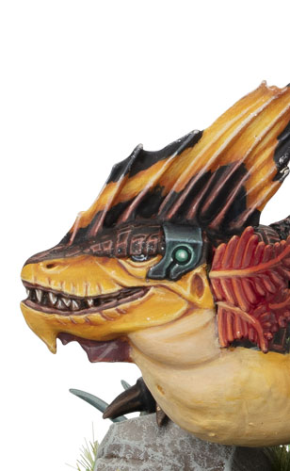
SPAWN OF CHOTEC
5’’
Move
8
Health
5+
Save
1
Control
Ranged Weapons | Range | Attacks | Hit | Wound | Rend | Dmg
Glob of Flame Acid Companion | 16’’ | 1 | 4+ | 2+ | 2 | D3+3
Stream of Fire Anti-Infantry (+1 Rend) Companion | 10’’ | 5 | 2+ | 3+ | 1 | 1
Melee Weapons | Attacks | Hit | Wound | Rend | Damage
Flery Maw Companion | 3 | 3+ | 3+ | 2 | 3
Passive | Passive
Acid-fuelled Flame | Sun Acolytes
Each time this unit uses a SHOOT ability, you must pick either its Glob of Flame Acid or its Stream of Fire ranged weapon. In addition, after resolving shooting attacks made with this unit’s Glob of Flame Acid, if any damage points were allocated to an enemy unit by those attacks, subtract 1 from save rolls for that enemy unit for the rest of the turn. | This unit has a crew of 3 Sun Acolytes that are tokens. Add 1 to this unit’s control score for each Sun Acolyte it has. If this unit has no Sun Acolytes, it has a maximum control score of 1 for the rest of the battle. Each time you make an unmodified save roll of 1 for this unit, remove 1 of its Sun Acolytes from the battlefield after the ATTACK ability has been resolved (the damage point is still inflicted).
Keywords : Beast, Order, Seraphon, Skink

Slide 26
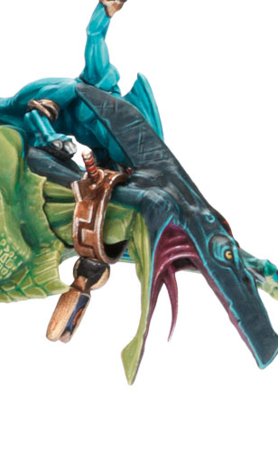
TERRADON RIDERS
14’’
Move
3
Health
5+
Save
1
Control
Ranged Weapons | Range | Attacks | Hit | Wound | Rend | Dmg
Javelin and Bolas Crit (Auto wound) | 10’’ | 3 | 4+ | 5+ | 0 | 1
Melee Weapons | Attacks | Hit | Wound | Rend | Damage
Terradon’s Razor-sharp Jaws Companion | 3 | 4+ | 3+ | 1 | 1
Passive | Your Mouvement Phase | Passive
Dispersed Formation | Deadly Cargo | Attack From on High
This unit has a coherency range of 2’’ | Pick an enemy unit that this unit passed across this phase to be the target. Roll a dice for each model in this unit, and add 2 to each roll if this unit is within the combat ranges of any friendly Terradon Chief units. For each 5+: • Inflict 1 mortal damage • If any damage points are allocated by this ability and the target does not have FLY, the target cannot use RUN abilities until the start of your next turn. | Subtract 1 from hit rolls for shooting attacks that target this unit.
Keywords : Cavalry, Champion, Fly, Order, Seraphon, Skink

Slide 27
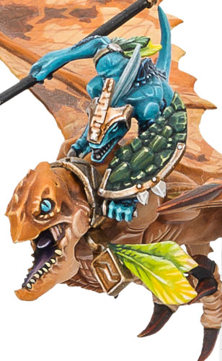
RIPPERDACTYL RIDERS
14’’
Move
3
Health
5+
Save
1
Control
Melee Weapons | Attacks | Hit | Wound | Rend | Damage
Ripperdactyl’s Tearing Jaws Charge (+1 Damage) Companion | 3 | 4+ | 3+ | 1 | 1
Moonstone Warspear Anti-CAVALRY (+1 Rend) | 2 | 4+ | 4+ | 0 | 1
Passive | Once Per Battle (Army) Deployment Phase | Passive
Dispersed Formation | Bloat Toad | Toad Rage
This unit has a coherency range of 2’’ | You receive 1 Blot Toad token for each Ripperdactyl Chief or Ripperdactyl Riders unit in your army, to a maximum of 3 tokens. Pick a number of enemy units equal to the number of Blot Toads you have to be the targets. Place a Blot Toad next to each target. | Add 1 to the Attacks characteristic of this unit’s Ripperdactyl’s Tearing Jaws while it is in combat with any units that have a Blot Toad.
Keywords : Cavalry, Champion, Fly, Order, Seraphon, Skink

Slide 28
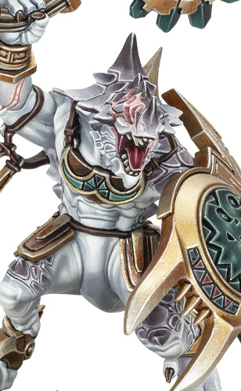
SUNBLOOD PACK
5’’
Move
3
Health
4+
Save
2
Control
Melee Weapons | Attacks | Hit | Wound | Rend | Damage
Celestite Weapons | 3 | 3+ | 3+ | 1 | 2
Passive | Passive | Any Combat Phase
Scaled Protector | Starspawned | Venomite Swarm
Ignore negative and positive modifiers to save rolls for this unit. | Ignore the first damage point that would be allocated to friendly SAURUS and KROXIGOR units each phase while they are wholly within 12" of this unit. | Pick an enemy unit in combat with this unit to be the target.
 |  | If this unit’s Venomites token is on the battlefield, roll a D3. On a 1, remove this unit’s Venomites token from the battlefield. On a 2+, inflict an amount of mortal damage on the target equal to the roll.
Keywords : Hero, Infantry, Order, Seraphon, Saurus

Slide 29
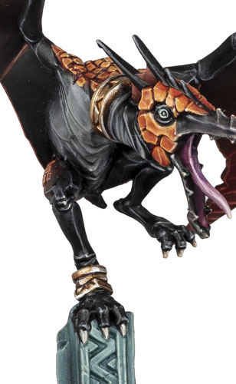
TERRAWINGS
12’’
Move
2
Health
5+
Save
1
Control
Melee Weapons | Attacks | Hit | Wound | Rend | Damage
Snapping Beaks Companion | 3 | 4+ | 4+ | 0 | 1
Your Shooting Phase | Passive
Scaled Protector | Beast
Pick an enemy unit within 10" of this unit to be the target. Roll a D3. If the roll exceeds the target’s Control characteristic, the target cannot use commands for the rest of the turn. | This unit has a maximum control score of 1.
Keywords : Beast, Fly, Order, Seraphon

Slide 30
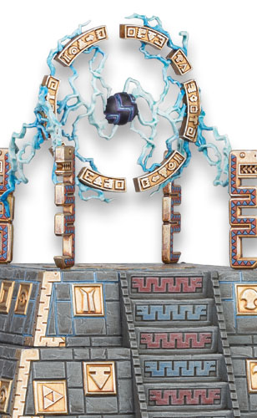
REALMSHAPER ENGINE
0
Move
15
Health
4+
Save
0
Control
Wargear | Your Hero Phase | Passive
 | If there are any friendly SERAPHON WIZARDS within 3" of this terrain feature, pick another terrain feature within 24" of this terrain feature, then pick up to 3 enemy units within 3" of that terrain feature to be the targets.
The following universal terrain abilities apply to this terrain feature (Terrain, 1.2): Cover, Unstable | Roll a D3 for each target. On a 2+, inflict an amount of mortal damage on the target equal to the roll. If that terrain feature has a Health characteristic, inflict D3 mortal damage on it. | Add 1 to hit rolls for combat attacks made by friendly SAURUS or KROXIGOR units that target an enemy unit while that enemy unit is within 9" of this terrain feature.
Keywords : Faction terrain, Order, Seraphon

Slide 31

KRONDSPINE INCARNATE OF GHUR
10’’
Move
12
Health
4+
Save
6+
Ward
8+
Banish
Melee Weapons | Attacks | Hit | Wound | Rend | Damage
Amberstone Claws and Fangs Anti-Manifestation (+1 Rend) | 6 | 4+ | 2+ | 2 | 3
Your Hero Phase
If there is not a friendly Krondspine Incarnate of Ghur, pick a friendly WIZARD to cast this spell, then make a casting roll of 2D6.
Set up a Krondspine Incarnate of Ghur wholly within 12’’ of the caster, visible to them and more than 9’’ from all enemy units.
Keywords : Summon, Spell
8
End of Any Turn | Passive | Passive
Devourer of magics | Wild Form | Arcane Predator
If this Manifestation destroyed any enemy Manifestation this turn, Heal (6) this Manifestation. | Each time this Manifestation is targeted by the ‘Banish Manifestation’ ability, if it would be banished, it is not banished. Instead, allocate 6 damage points to it (ward rolls cannot be made for those damage points) | You can add 1 to the number of dice rolled when making charge rolls for this Manifestation, to a maximum of 3, while it is within 18’’ of any enemy Manifestations. Must end ½’’ from enemy an Manifestation.
Keywords : Manifestation, Endless Spell, Incarnate, Fly, Ward (6+)

Slide 32
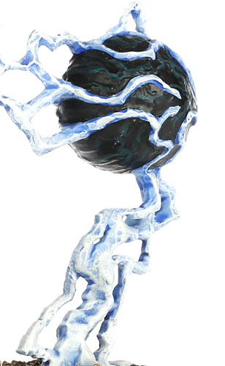
GEMINIDS OF UHL-GYSH
8’’
Move
8
Health
6+
Save
6+
Ward
6+
Banish
Melee Weapons | Attacks | Hit | Wound | Rend | Damage
Tendrils of Light and Shadow | 4 | 3+ | 3+ | 1 | D3
Your Hero Phase
If there is not a friendly Geminids of Uhl-Gysh, pick a friendly WIZARD to cast this spell, then make a casting roll of 2D6.
Set up a Geminids of Uhl-Gysh endless spell wholly within 12’’ of the caster, visible to them and more than 9’’ from all enemy units.
Keywords : Summon, Spell
7
Passive | Passive
Multiple Parts | Tendrils of Shadow and Light
When a number of damage points equal to this Manifestation’s Health characteristic are allocated to it, this Manifestation is destroyed and both its parts are removed from play. Each time this Manifestation moves, both its parts must end within 9’’ of each other. Each part of this Manifestation is armed with Tendrils of Light and Shadow. | Enemy units cannot use commands while they are within 3’’ of either part of this Manifestation.
Keywords : Manifestation, Endless Spell, Fly, Ward (6+)

Slide 33

PRISMATIC PALISADE
0
Move
8
Health
4+
Save
6+
Ward
7+
Banish
Your Hero Phase
If there is not a friendly Prismatic Palisade, pick a friendly WIZARD to cast this spell, then make a casting roll of 2D6.
Set up a Prismatic Palisade endless spell wholly within 18’’ of the caster and visible to them.
Keywords : Summon, Spell
7
Passive
Blinding Light
This Manifestation cannot be targeted by shooting attacks. In addition, a unit cannot be targeted by shooting attacks if it is impossible to draw a straight line from a model in the attacking unit to a model in the target unit without that line passing across this Manifestation.
Keywords : Manifestation, Endless Spell, Ward (6+)

Slide 34
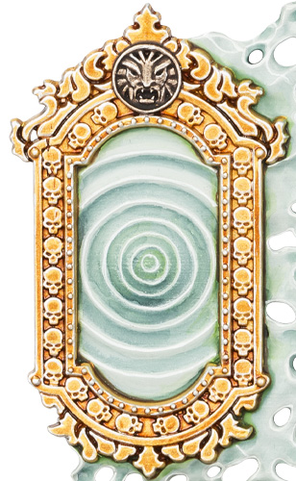
UMBRAL SPELLPORTAL
0
Move
8
Health
5+
Save
6+
Ward
6+
Banish
Your Hero Phase
If there is not a friendly Umbral Spellportal, pick a friendly WIZARD to cast this spell, then make a casting roll of 2D6.
Set up an Umbral Spellportal endless spell wholly within 18’’ of the caster and visible to them. An Umbral Spellportal has 2 parts that must be set up within 9’’ of each other.
Keywords : Summon, Spell
7
Passive | Your Hero Phase
Multiple Parts | Arcane Passage
When a number of damage points equal to this Manifestation’s Health characteristic are allocated to it, this Manifestation is destroyed and both its parts are removed from play. | Pick a friendly Wizard within 3" of this Manifestation to be the target. The next time the target uses a non-Summon Spell ability this phase, add 1 to the casting value of that spell. When picking targets for that spell, you can measure range and visibility from either part of this Manifestation instead of from the caster, and your opponent can measure range and visibility to either part of this Manifestation instead of to the caster for the purposes of the ‘Unbind’ ability.
Keywords : Manifestation, Endless Spell, Ward (6+)

Slide 35
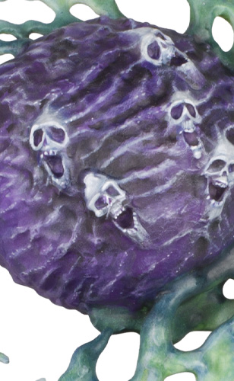
MALEVOLENT MAELSTROM
8’’
Move
6
Health
6+
Save
6+
Ward
7+
Banish
Melee Weapons | Attacks | Hit | Wound | Rend | Damage
Lashing Tendrils of Energy Crit (2 Hits) | 2D6 | 4+ | 3+ | 0 | 1
Your Hero Phase
If there is not a friendly Malevolent Maelstrom, pick a friendly WIZARD to cast this spell, then make a casting roll of 2D6.
Set up a Malevolent Maelstrom wholly within 12’’ of the caster, visible to them and more than 9’’ from all enemy units.
Keywords : Summon, Spell
6
Passive | End of Any Turn
Necrotic Vortex | Morbid Detonation
Give this Manifestation 1 maelstrom point: • Each time this Manifestation is set up. • Each time a unit successfully casts a spell while it is within 12" of this Manifestation. • Each time a model is slain within 12" of this Manifestation. This Manifestation can have a maximum of 6 maelstrom points at once. | You must, and can only, use this ability if this unit has 6 maelstrom points. Pick each unit (friendly and enemy) within 9" of it to be the targets. Roll a dice for each target. On a 2+, inflict an amount of mortal damage on the target equal to the roll. Then, this Manifestation is destroyed.
Keywords : Manifestation, Endless Spell, Fly, Ward (6+)

Slide 36
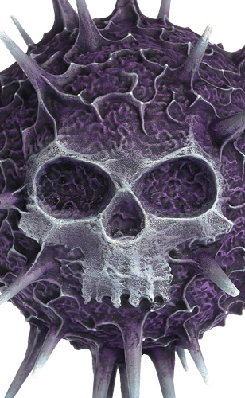
PURPLE SUN OF SHYISH
8’’
Move
10
Health
6+
Save
6+
Ward
7+
Banish
Melee Weapons | Attacks | Hit | Wound | Rend | Damage
Transmuting Rays Crit (Mortal) | 2D6 | 4+ | 3+ | 1 | 1
Your Hero Phase
If there is not a friendly Purple Sun of Shyish, pick a friendly WIZARD to cast this spell, then make a casting roll of 2D6.
Set up a Purple Sun of Shyish wholly within 12’’ of the caster, visible to them and more than 9’’ from all enemy units.
Keywords : Summon, Spell
8
Your Movement Phase | Passive
End Given Form | Pull of the Nadir
This Manifestation can move a distance up to its Move characteristic. It can pass through models during that move but cannot end that move in combat. Then, pick up to 3 enemy units that this Manifestation passed across during that move to be the targets. Roll a D3 for each target. On a 2+, inflict an amount of mortal damage on the target equal to the roll. | Subtract 1 from save rolls for enemy units while they are within 3" of this Manifestation.
Keywords : Manifestation, Endless Spell, Fly, Ward (6+)

Slide 37
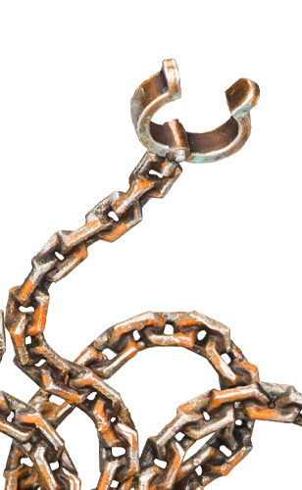
SOULSNARE SHACKLES
0
Move
6
Health
6+
Save
6+
Ward
7+
Banish
Your Hero Phase
If there is not a friendly Soulsnare Shackles, pick a friendly WIZARD to cast this spell, then make a casting roll of 2D6.
Set up a Soulsnare Shackles wholly within 18’’ of the caster, visible to them. A Soulsnare Shackles has 3 parts that must each be set up within 3’’ of at least 1 other.
Keywords : Summon, Spell
6
Passive | Any Hero Phase
Multiple Parts | Bound for the Great Oubliette
When a number of damage points equal to this Manifestation’s Health characteristic are allocated to it, this Manifestation is destroyed and all its parts are removed from play. | For each part of this Manifestation, you can pick an enemy unit within 3" of that part to be the targets. You cannot pick the same unit to be the target of this ability more than once per turn. Roll a D3 for each target. On a 2+: • Inflict an amount of mortal damage on the target equal to the roll. • Subtract a number of inches equal to the roll from the target’s Move characteristic for the rest of the turn.
Keywords : Manifestation, Endless Spell, Ward (6+)

Slide 38
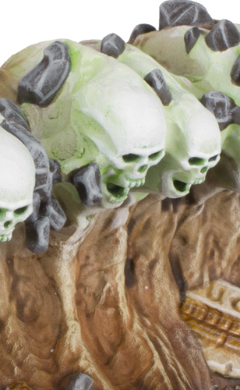
SUFFOCATING GRAVETIDE
12’’
Move
8
Health
6+
Save
6+
Ward
7+
Banish
Melee Weapons | Attacks | Hit | Wound | Rend | Damage
Spectral Riptide Charge (+1 Damage) | 8 | 4+ | 3+ | 1 | 1
Your Hero Phase
If there is not a friendly Suffocating Gravetide, pick a friendly WIZARD to cast this spell, then make a casting roll of 2D6.
Set up a Suffocating Gravetide wholly within 12’’ of the caster, visible to them and more than 9’’ from all enemy units.
Keywords : Summon, Spell
8
Your Movement Phase
Pulled to the Grave
This Manifestation can move a distance up to its Move characteristic. It can pass through models during that move but cannot end that move in combat. Then, you can pick an enemy unit that this Manifestation passed across during that move to be the target. Roll a dice for each model in the target unit. For each 5+, inflict 1 mortal damage on the target.
Keywords : Manifestation, Endless Spell, Fly, Ward (6+)

Slide 39
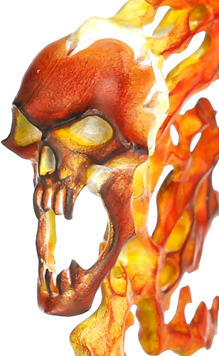
THE BURNING HEAD
8’’
Move
6
Health
6+
Save
6+
Ward
6+
Banish
Ranged Weapons | Range | Attacks | Hit | Wound | Rend | Dmg
Burning Breath Anti-War Machine (+1 Rend) Shoot in combat | 10’’ | D6 | 4+ | 3+ | 2 | 1
Melee Weapons | Attacks | Hit | Wound | Rend | Damage
Flaming Maw Anti-War Machine (+1 Rend) | 2D6 | 4+ | 3+ | 2 | 1
Your Hero Phase
If there is not a friendly The Burning Head, pick a friendly WIZARD to cast this spell, then make a casting roll of 2D6.
Set up The Burning Head, wholly within 12’’ of the caster, visible to them and more than 9’’ from all enemy units.
Keywords : Summon, Spell
5
Passive
Burning Up
Each time this MANIFESTATION uses a SHOOT ability, after that ability has been resolved, allocate 1 damage point to this MANIFESTATION (ward rolls cannot be made for that damage point).
Keywords : Manifestation, Endless Spell, Fly, Ward (6+)

Slide 40
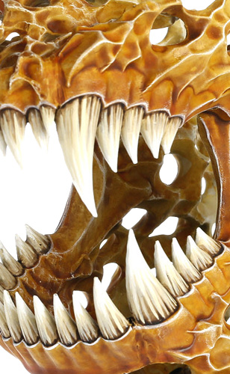
RAVENAK’S GNASHING JAWS
3D6’’
Move
10
Health
6+
Save
6+
Ward
7+
Banish
Melee Weapons | Attacks | Hit | Wound | Rend | Damage
Gnashing Jaws Charge (+1 Damage) | 10 | 4+ | 2+ | 1 | 1
Your Hero Phase
If there is not a friendly Ravenak’s Gnashing Jaws, pick a friendly WIZARD to cast this spell, then make a casting roll of 2D6.
Set up a Ravenak’s Gnashing Jaws wholly within 12’’ of the caster, visible to them and more than 9’’ from all enemy units.
Keywords : Summon, Spell
7
Any Charge Phase
Ravening Hunger
If this MANIFESTATION charged this turn, pick an enemy unit within 1" of it to be the target. Roll 10 dice. For each 5+, inflict 1 mortal damage on the target.
Keywords : Manifestation, Endless Spell, Fly, Ward (6+)

Slide 41

EMERALD LIFESWARM
8’’
Move
5
Health
6+
Save
6+
Ward
7+
Banish
Melee Weapons | Attacks | Hit | Wound | Rend | Damage
Swarming Bites Anti-infantry (+1 Rend) | 2D6 | 4+ | 4+ | 0 | 1
Your Hero Phase
If there is not a friendly Emerald Lifeswarm, pick a friendly WIZARD to cast this spell, then make a casting roll of 2D6.
Set up a Emerald Lifeswarmwholly within 12’’ of the caster, visible to them and more than 9’’ from all enemy units.
Keywords : Summon, Spell
6
Your Movement Phase | End of Any Turn
Bounteous Healing | Restored Vigour
Pick a friendy unit within 3’’ of this Manifestation to be the target. Heal (3) the target. | Heal (3) this Manifestation.
Keywords : Manifestation, Endless Spell, Fly, Ward (6+)

Slide 42
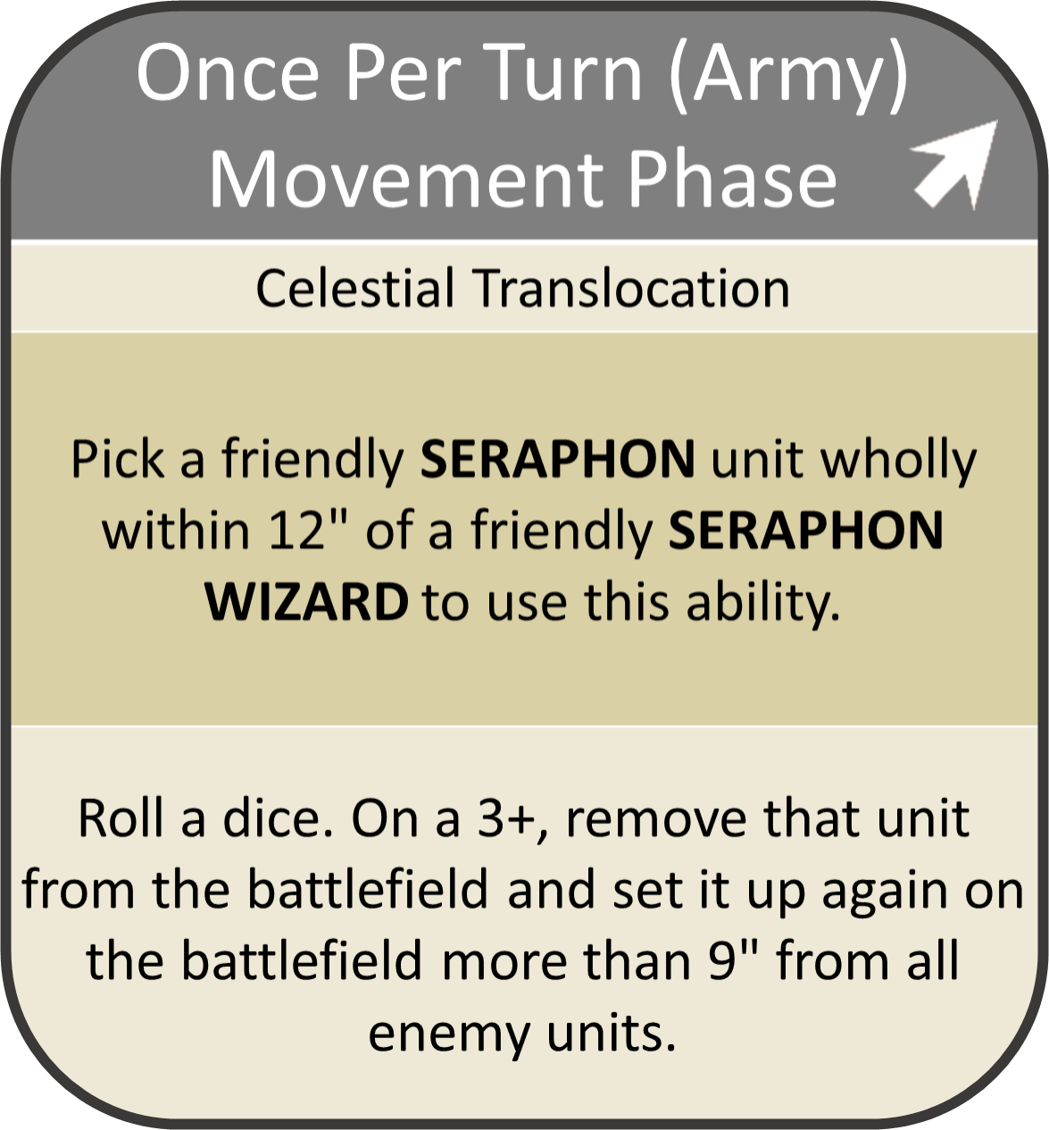
Your Movement Phase

Slide 43
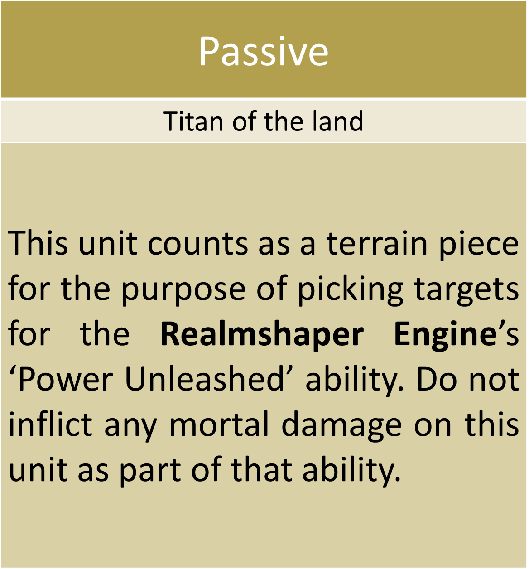
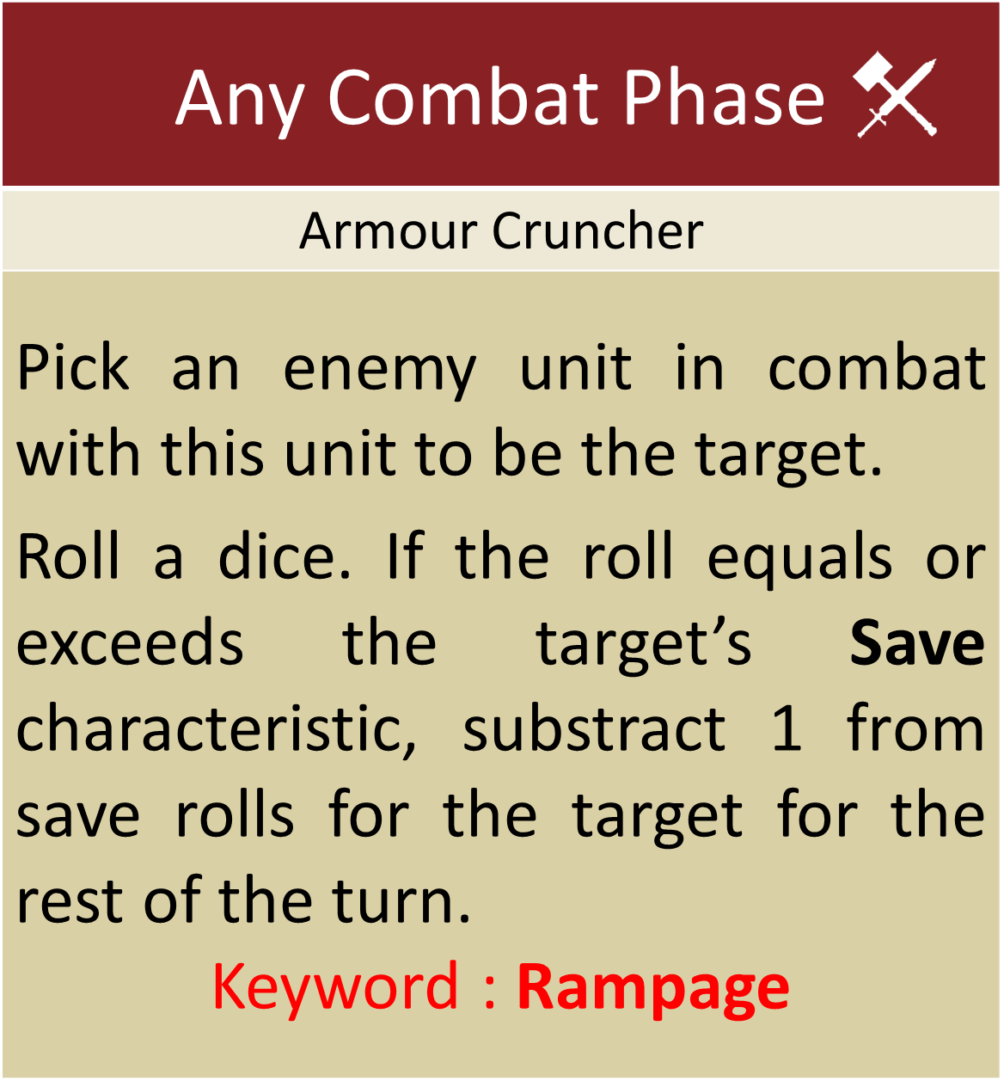
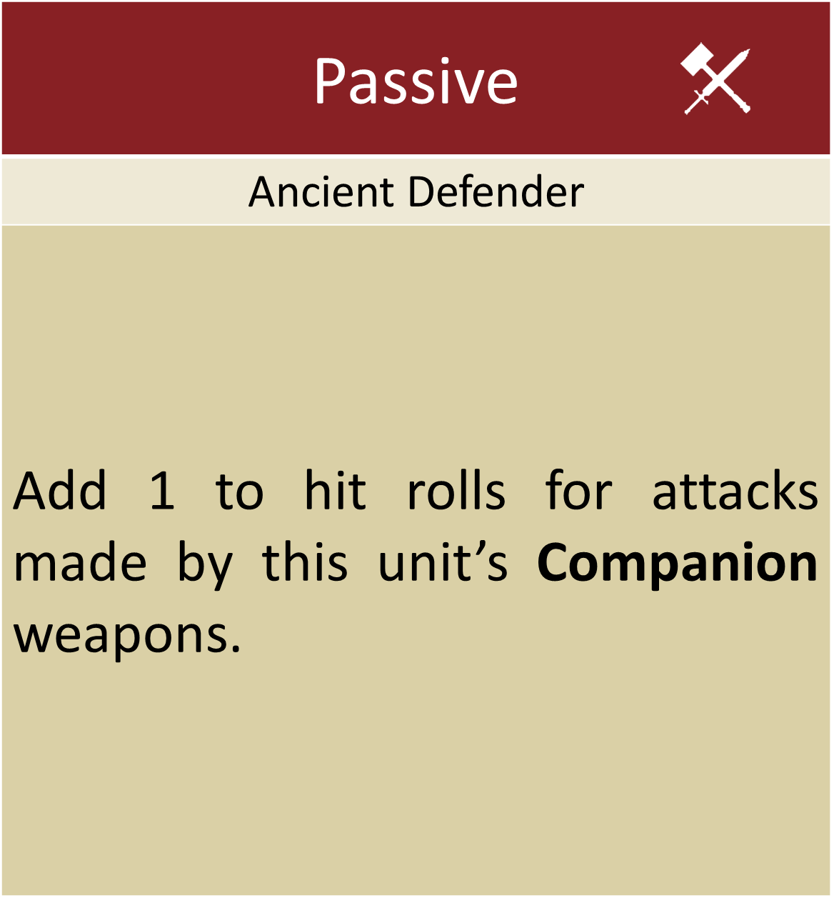
Passive
Titan of the land
This unit counts as a terrain piece for the purpose of picking targets for the Realmshaper Engine’s ‘Power Unleashed’ ability. Do not inflict any mortal damage on this unit as part of that ability.
Passive
Ancient Defender
Add 1 to hit rolls for attacks made by this unit’s Companion weapons.

Slide 44
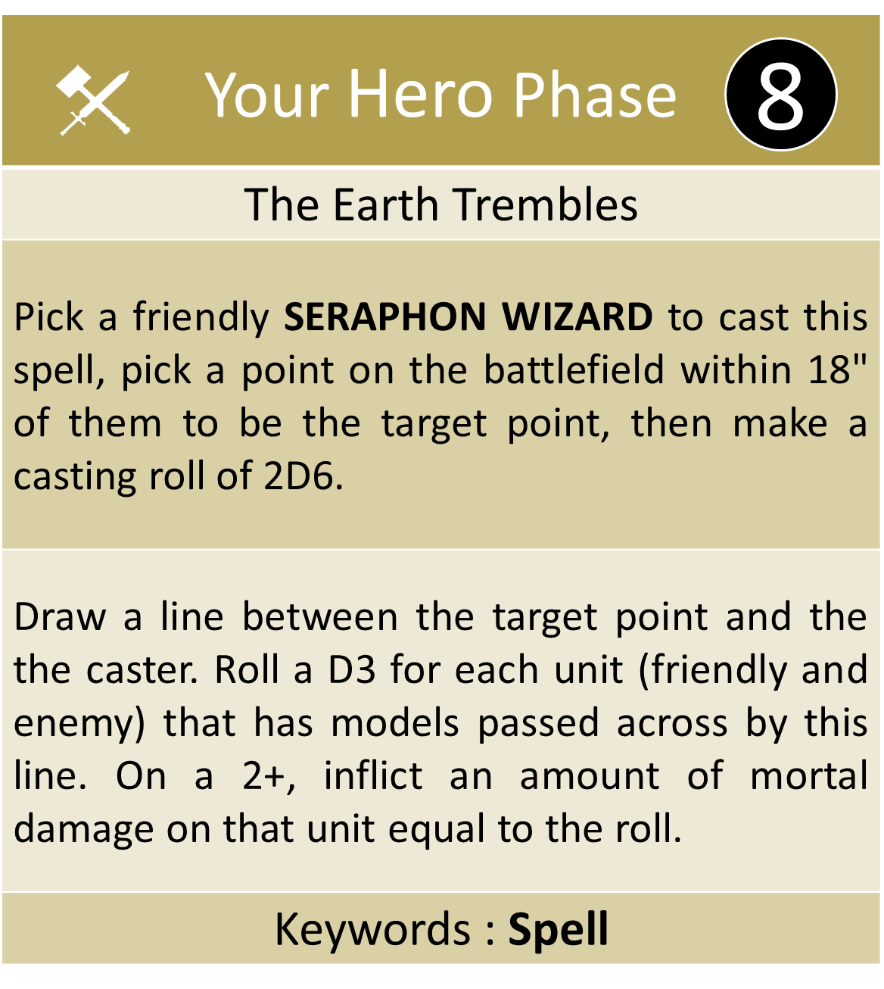
Your Hero Phase
Light of Chotec
Pick a friendly SERAPHON WIZARD to cast this spell, pick a visible friendly SERAPHON unit wholly within 12" of them to be the target, then make a casting roll of 2D6.
Roll a number of dice equal to the number of damage points the target has. For each 4+, Heal (1) the target.
Keywords : Spell, Unlimited
6
Your Hero Phase
Empowered Celestite
Pick a friendly SERAPHON WIZARD to cast this spell, pick a visible friendly SAURUS unit wholly within 12" of them to be the target, then make a casting roll of 2D6.
Add 1 to the Rend characteristic of the target’s melee weapons for the rest of the turn.
Keywords : Spell
7
Your Hero Phase
The Earth Trembles
Pick a friendly SERAPHON WIZARD to cast this spell, pick a point on the battlefield within 18" of them to be the target point, then make a casting roll of 2D6.
Draw a line between the target point and the the caster. Roll a D3 for each unit (friendly and enemy) that has models passed across by this line. On a 2+, inflict an amount of mortal damage on that unit equal to the roll.
Keywords : Spell
8

Slide 45
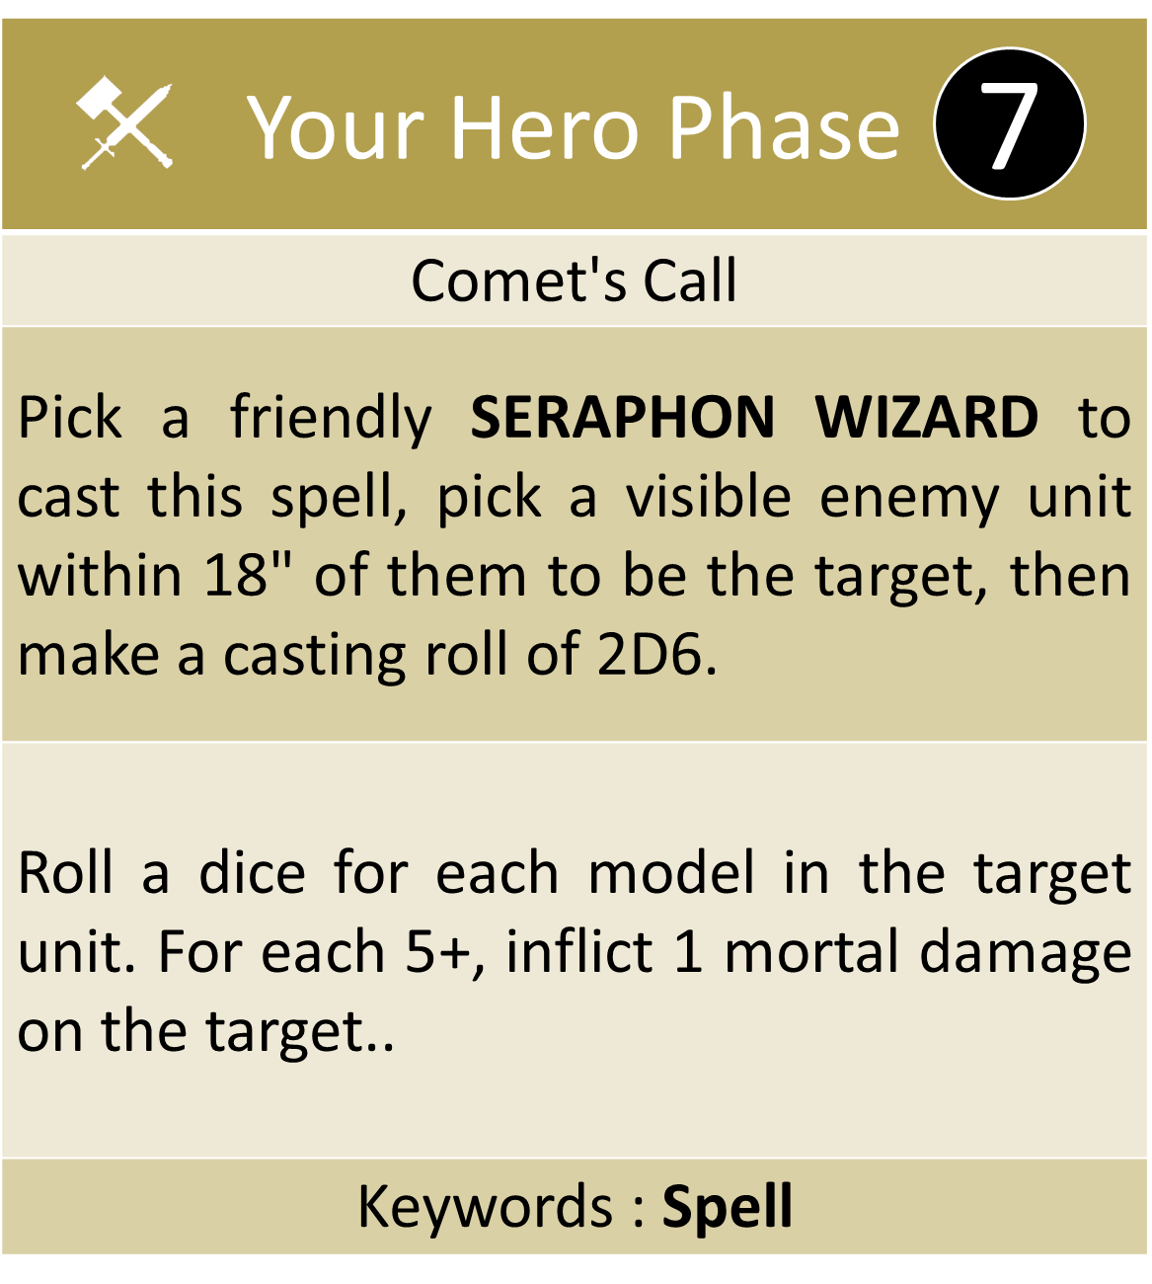
Your Hero Phase
Comet's Call
Pick a friendly SERAPHON WIZARD to cast this spell, pick a visible enemy unit within 18" of them to be the target, then make a casting roll of 2D6.
Roll a dice for each model in the target unit. For each 5+, inflict 1 mortal damage on the target..
Keywords : Spell
7
Your Hero Phase
Speed of Huanchi
Pick a friendly SERAPHON WIZARD to cast this spell, pick a visible friendly SERAPHON unit wholly within 12" of them to be the target, then make a casting roll of 2D6.
Until the start of your next turn, the target can use a RUN ability and still use SHOOT and/or CHARGE abilities later in the turn.
Keywords : Spell
6
Your Hero Phase
Mystical Unforging
Pick a friendly SERAPHON WIZARD to cast this spell, pick a visible enemy unit within 12" of them to be the target, then make a casting roll of 2D6.
Subtract 1 from the Rend characteristic of the target’s weapons until the start of your next turn.
Keywords : Spell, Unlimited
6

Slide 46
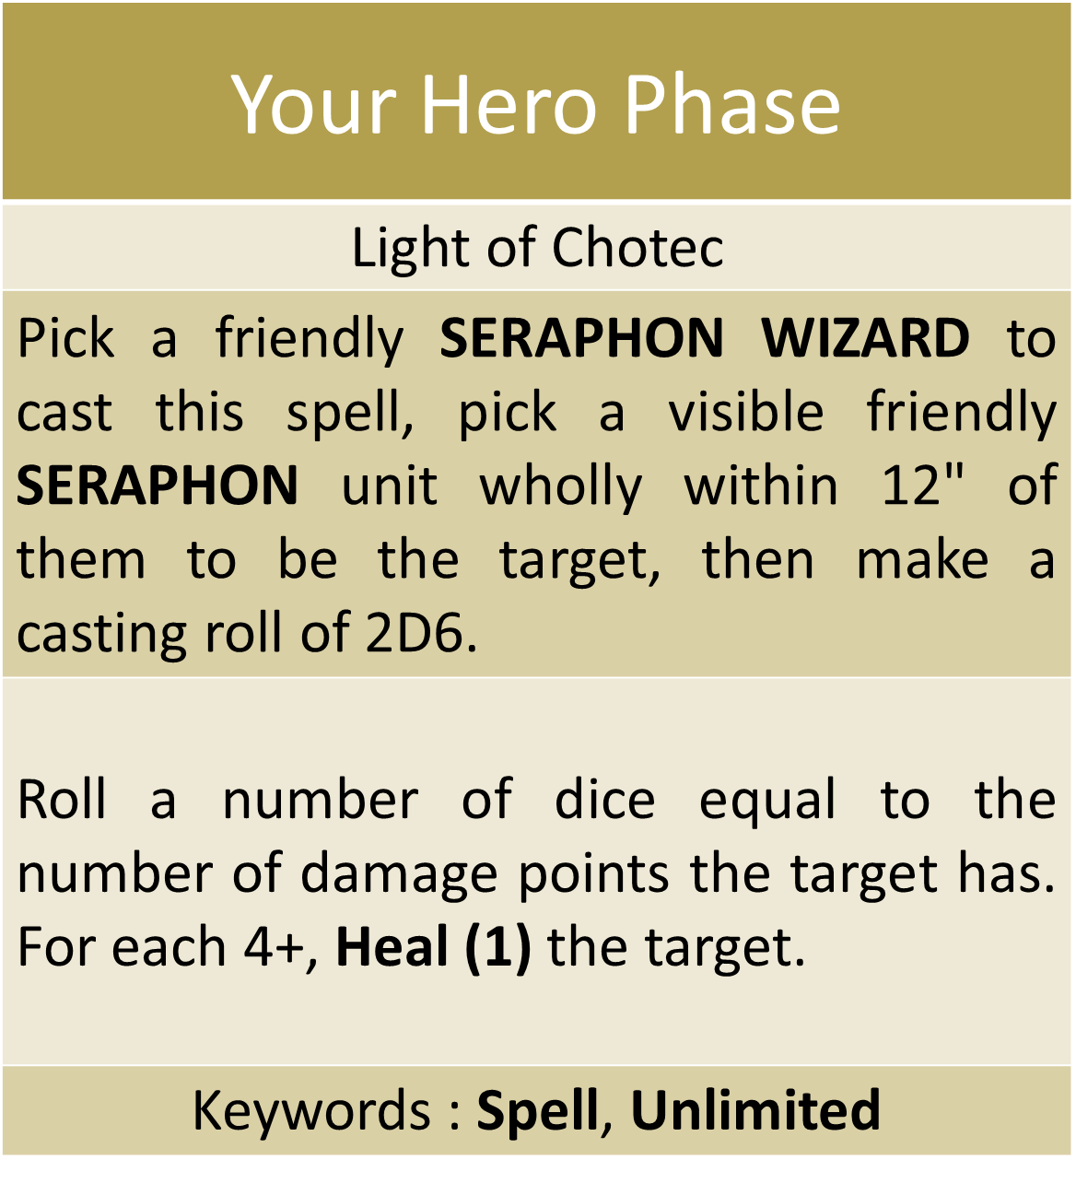
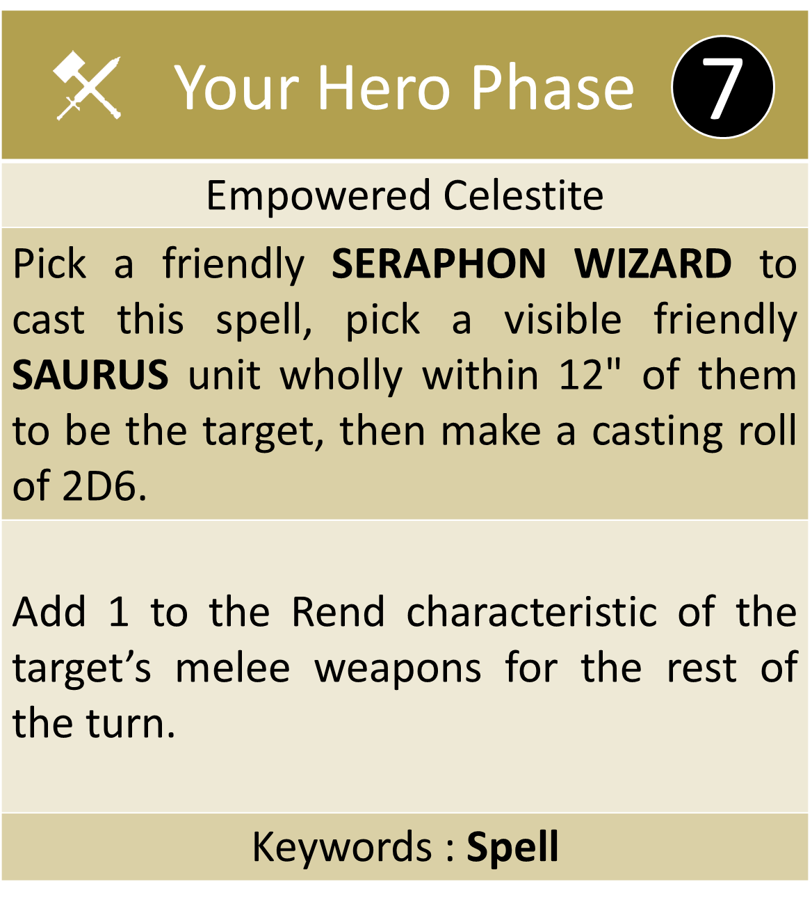
6

Slide 47
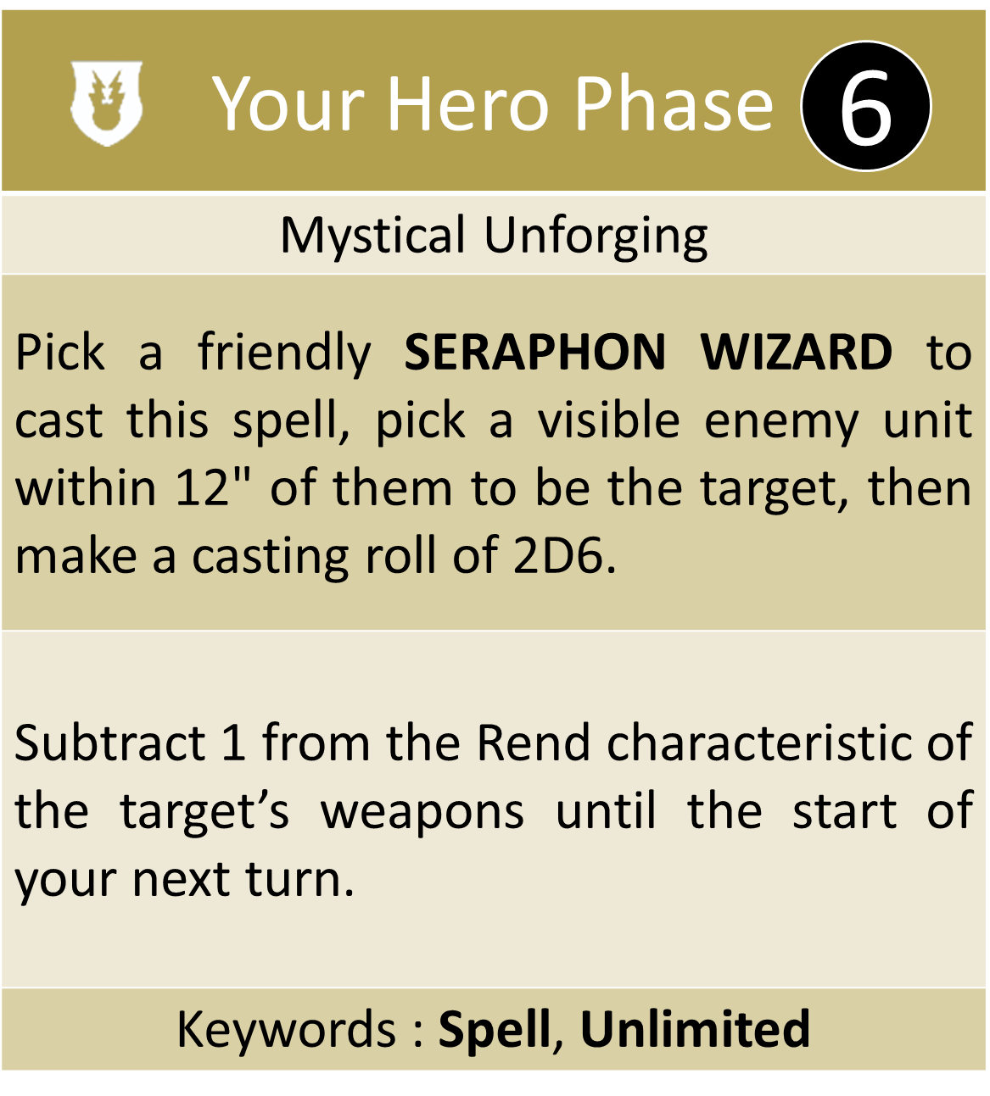
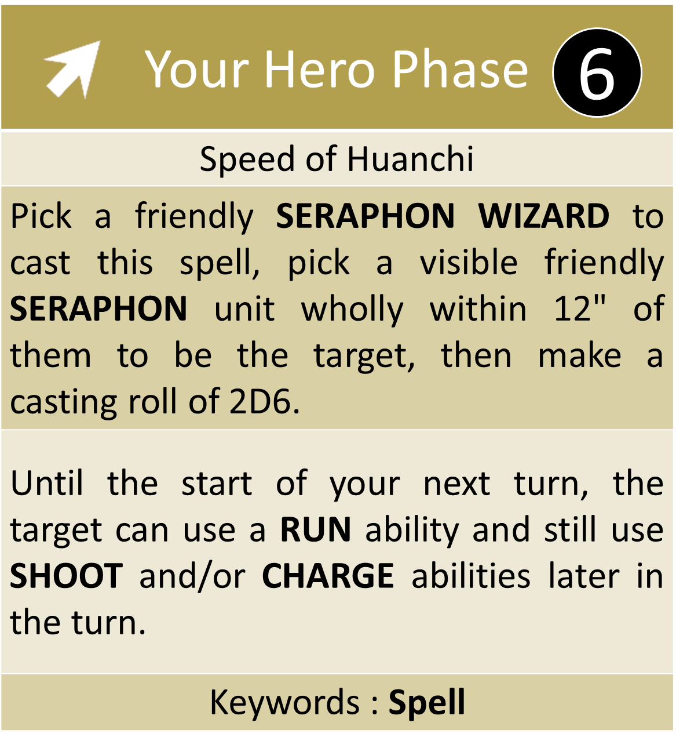

Slide 48
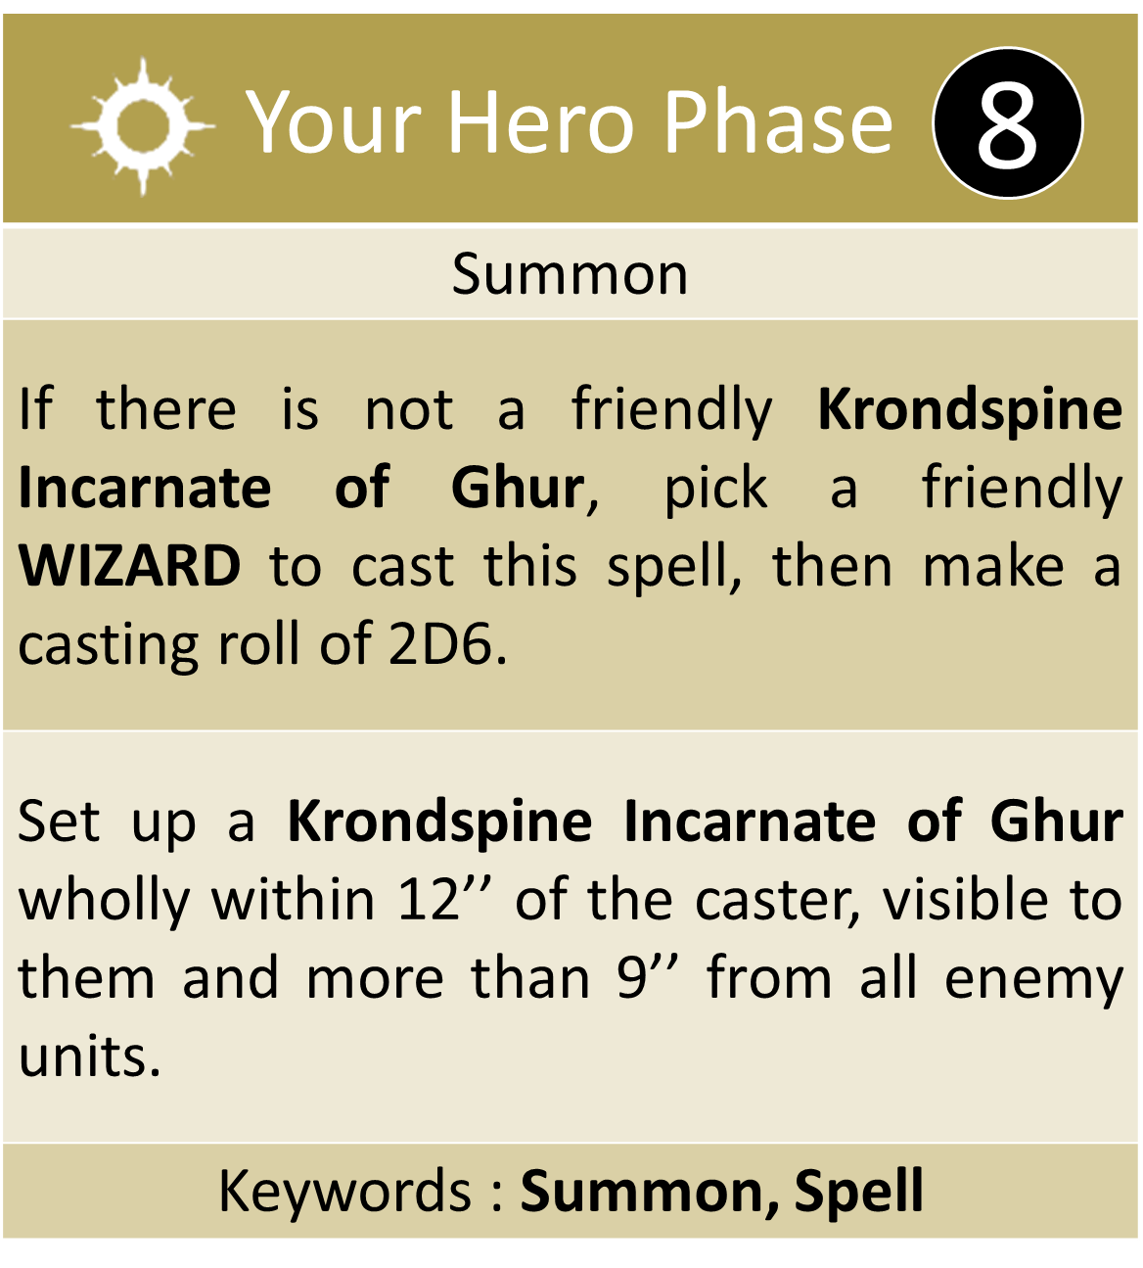
Your Hero Phase
Summon
If there is not a friendly Krondspine Incarnate of Ghur, pick a friendly WIZARD to cast this spell, then make a casting roll of 2D6.
Set up a Krondspine Incarnate of Ghur wholly within 12’’ of the caster, visible to them and more than 9’’ from all enemy units.
Keywords : Summon, Spell
8

Slide 49
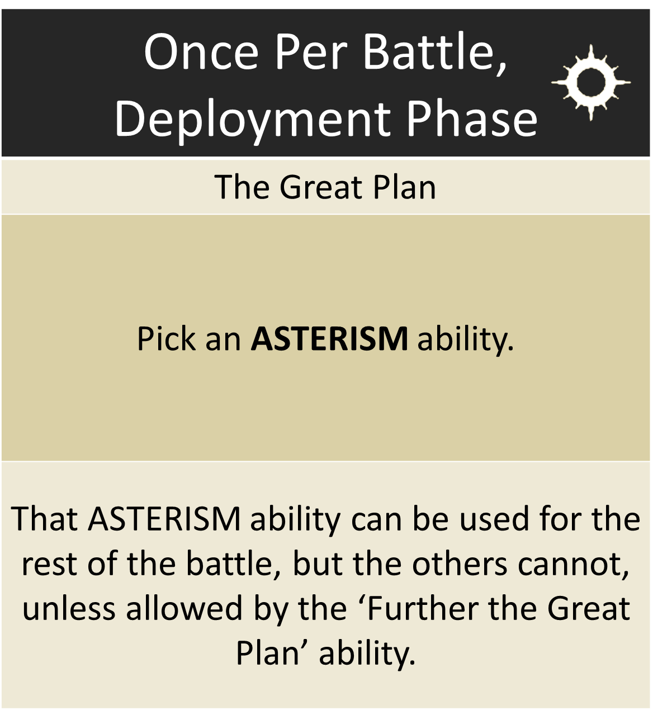

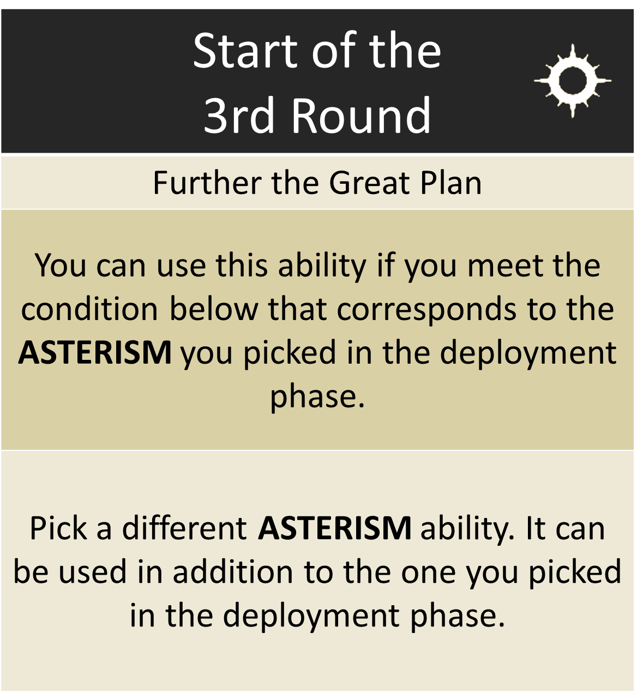
Once Per Battle, Deployment Phase
The Great Plan
Pick an ASTERISM ability.
That ASTERISM ability can be used for the rest of the battle, but the others cannot, unless allowed by the ‘Further the Great Plan’ ability.
Start of the 3rd Round
Further the Great Plan
You can use this ability if you meet the condition below that corresponds to the ASTERISM you picked in the deployment phase.
Pick a different ASTERISM ability. It can be used in addition to the one you picked in the deployment phase.

Slide 50


Slide 51




Passive
Sotek the Deliverer
Add 2 to the Move characteristic of friendly SERAPHON units.
Keyword : Asterism
Passive
Tepok the Seer
Add 1 to casting rolls for friendly SERAPHON units.
Condition T3 : There are any friendly SLANN units on the battlefield and no friendly SLANN units are in combat or have been destroyed.
Condition T3 : The enemy general is in combat or has been destroyed.
Condition T3 : 3 or more enemy units have been destroyed.
Passive
Quetzl the Preserver
Subtract 1 from the Rend characteristic of melee weapons for attacks that target friendly SERAPHON units that are wholly within friendly territory.
Keyword : Asterism
Passive
Itzl the Tamer
Companion weapons used by friendly SERAPHON units have Crit (2 Hits).
Keyword : Asterism
Condition T3 : There are no enemy units wholly within friendly territory.

Slide 52



Once Per Battle, Reaction: You declared the ‘Further the Great Plan’ ability
Keeper of the old ways
You can pick 2 different Asterism abilities instead of 1. They are both used in addition to the one you picked in the deployment phase.
Passive
Child of the stars
If this unit would be destroyed, before removing it from play, roll a dice. On a 3+, this unit is not destroyed and any remaining damage points inflicted on it have no effect. Then, Heal (D3) this unit. This unit cannot use this ability again for the rest of the battle.
Any Combat Phase
Chosen of Quetzl
Pick a visible friendly non-Monster Skink unit that is in combat and is wholly within 12" of this unit to be the target. Roll a dice. On a 3+, the target can move up to 8". It can move through the combat ranges of enemy units but cannot end that move in combat.

Slide 53



Once Per Battle, Reaction: You declared a SPELL ability for a friendly SERAPHON WIZARD within this unit’s combat range
Coatl Familiar
Add D6 to the casting roll for that spell.
Any Hero Phase
Incandescent Rectrices
Heal (D3) this unit.
Passive
Bloorage Pendant
Add 1 to the Attacks characteristic of this unit’s melee weapons. Add 2 instead if the number of damage points allocated to this unit is equal to or greater than half of this unit’s Health characteristic (rounding up).

Slide 54





Commands 25/26
Add 1 to hit roll for attacks made as part of that Attack ability. This also affects weapons that have the Companion weapon ability. For the rest of the turn substract 1 from save rolls for the unit using this ability.
Add 1 to save rolls for that unit until that Attack ability has been resolved.

Slide 55


Battle Tactics 24/25
ORDER
Reclaim the Realms You complete this battle tactic at the end of your turn if there are 1 or more friendly units wholly within each quarter of the battlefield and more than 6" from all enemy Units | Slay the Tyrants You complete this battle tactic at the end of your turn if an enemy Hero was slain this turn by a combat attack made by a friendly unit
UNIVERSAL
Do Not Waiver You complete this battle tactic at the end of your turn if 2 or more friendly units fought this turn and no friendly units were destroyed this turn | Take Their Land Pick a terrain feature wholly or partially within enemy territory and wholly outside friendly territory. You complete this battle tactic at the end of your turn if you control that terrain feature at the end of your turn
Slay the Entourage Pick a unit in the enemy general’s regiment. You complete this battle tactic at the end of your turn if that unit is destroyed this turn | Seize the Centre You complete this battle tactic at the end of your turn if 2 or more friendly units are within 3" of the centre of the battlefield and are not in combat
Attack on Two Fronts You complete this battle tactic at the end of your turn if you control 2 or more objectives that you did not control at the start of your turn and at least 1 of those objectives was controlled by your opponent at the start of your turn | Take the Flanks You complete this battle tactic at the end of your turn if you have at least 1 friendly unit within 6" of each short battlefield edge, none of those units are wholly within friendly territory, and none of those units were set up this turn

Slide 56

Season Rules 25/26

